Slide 1
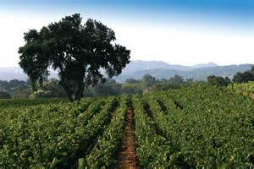
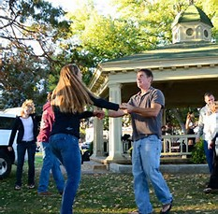
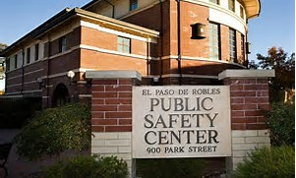
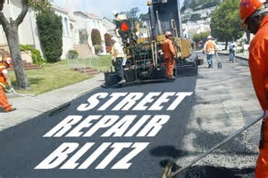
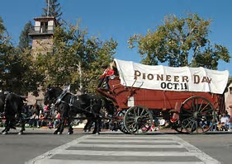
Paso Robles
The Next Big Thing
Where we’ve been. Where we are. Where we’re going.

Slide 2
Remember 1986?
Few hotels, restaurants, wineries, no shopping centers
Main street just started, no downtown movies
Carnegie library, old city hall, old police station
fire department located in current children’s museum
Leaking millions of dollars to other cities
Where we’ve been

Slide 3
Remember 1991?
Massive economic analysis of local retail market
Intense community discussion about the future
City “Quality of life” defined
New vision for paso robles
Where we’ve been

Slide 4
Paso robles today
City with High quality of life defined:
“A place where the great majority of citizens can live, work and shop”
Where we are

Slide 5
Paso robles today
General plan vision realized:
“Paso robles will be the retail hub of the north county”
Where we are

Slide 6
Paso robles tomorrow
Jobs and housing
Transportation and infrastructure
Public safety
Where we’re going

Slide 7
Jobs & Housing
Economic development lead agency
Airport commission
Housing constraints/opportunities committee
Continued support for tourism development
Where we’re going

Slide 8
Transportation & Infrastructure
Highway 46 access
City streets and alleys
Water/sewer pipeline network
Water/wastewater management
Where we’re going

Slide 9
Public safety
Factors affecting police and fire response levels
Staffing & facilities
Utilization of technology
Inter-agency cooperation
Where we’re going

Slide 10
Three “man-on-the-moon” statements
#1 - We will be the economic development center of the county
Retain/expand retail & tourism bases
Create opportunities for head-of-household jobs
Position ourselves as the “home of the next big thing”
Where we’re going

Slide 11
Three “man-on-the-moon” statements
#2 - We will be the model of modern transportation & Infrastructure
New pavement maintenance system
Effective access to and transit across Highway 46
Develop water/sewer line upgrade/maintenance plan
Where we’re going

Slide 12
Three “man-on-the-moon” statements
#3 - We will be the safest place to live and do business in the County
Create best-in-class 911 call center
Maintain optimal public safeTy staffing levels
Utilize technology to maximize effectiveness
Find new paradigms of cooperation with outside agencies
Where we’re going

Slide 13
Three “man-on-the-moon” statements
We will be the economic development center of the county
We will be the model of modern transportation & Infrastructure
We will be the safest place to live and do business in the County
Where we’re going

Slide 14
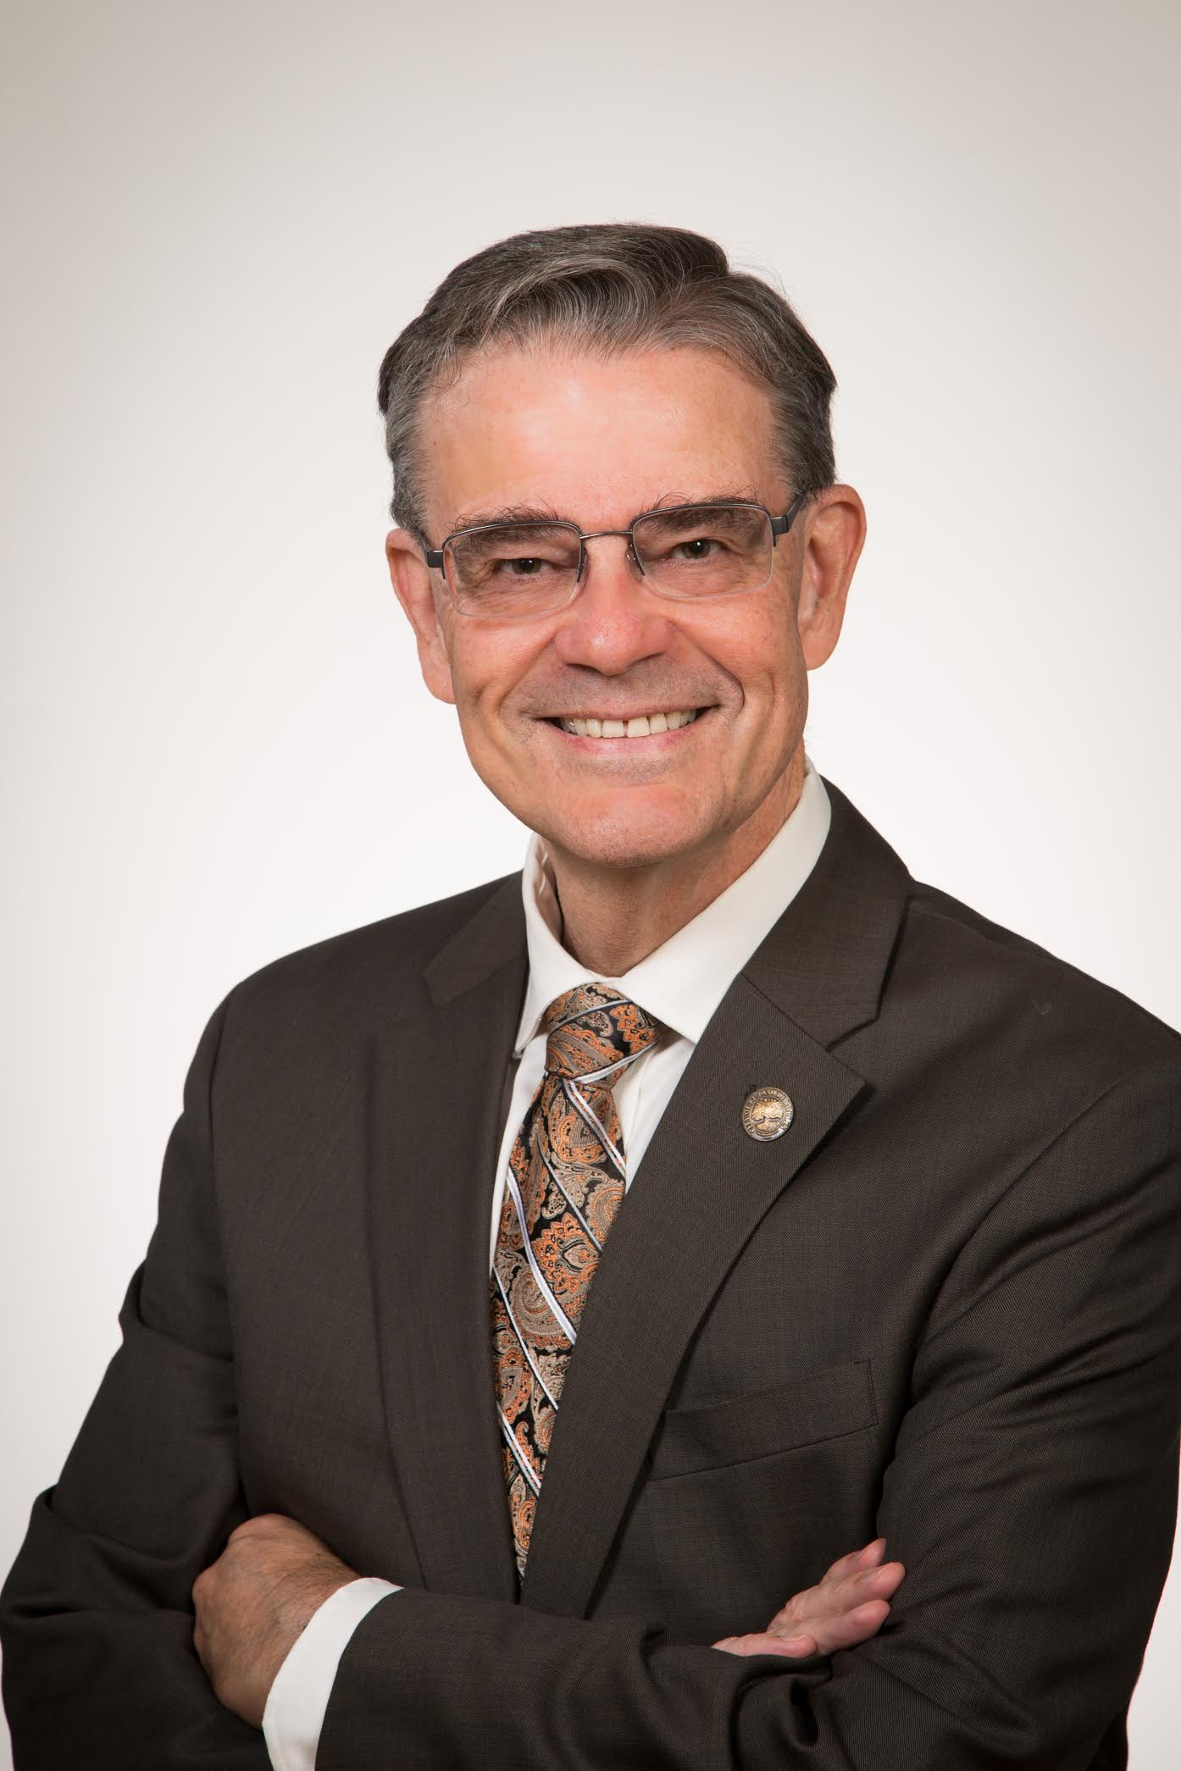
Paso Robles
We will be The Next Big Thing
Steven W. Martin
Mayor, Paso Robles California

